Slide 1
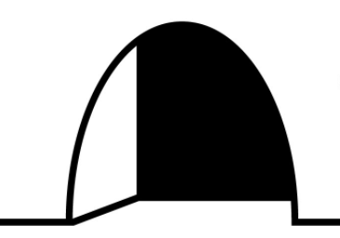
Building a Better Mousetrap
SEIS 744: Internet of Things
University of St. Thomas
Ken Tamura

Slide 2
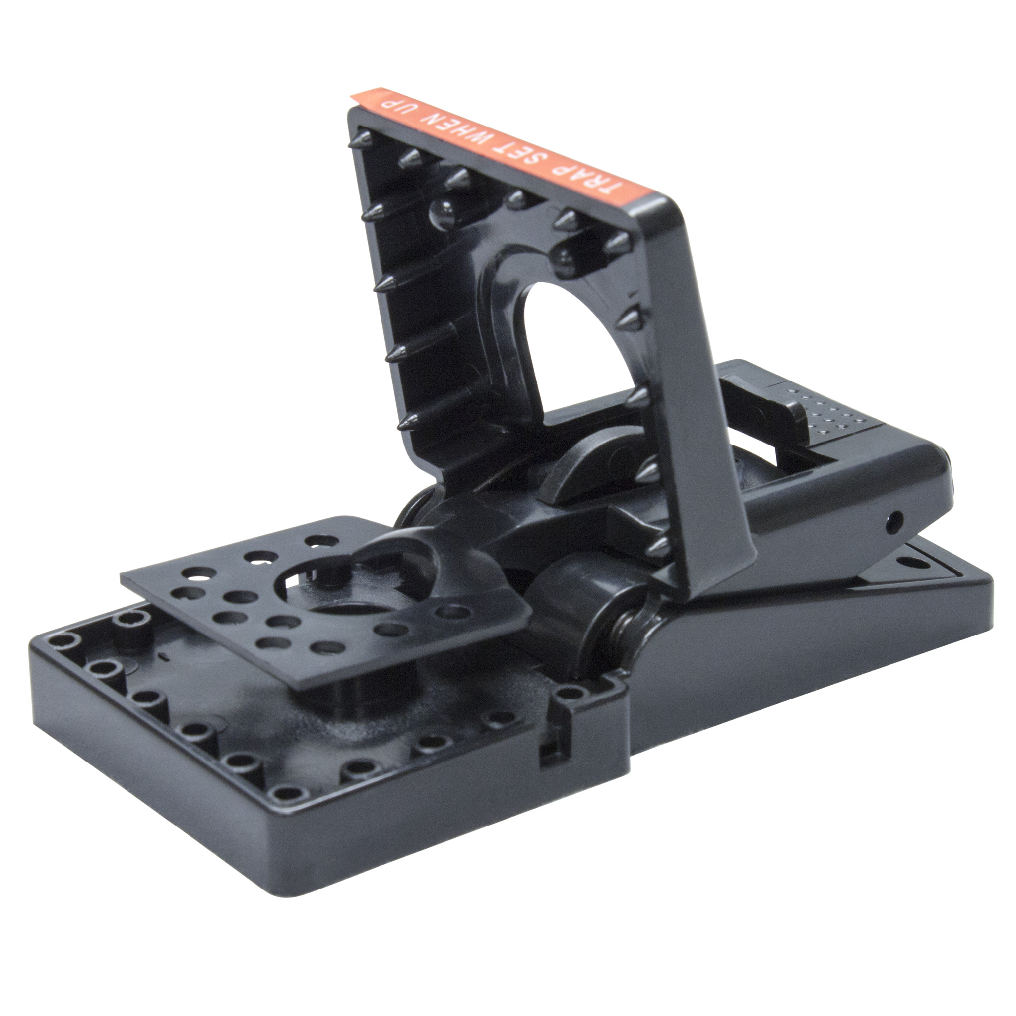


I would not like to have a mouse…
I would not like it in my house.
You will like it, you will see…
You will like it more with IoT!

Slide 3
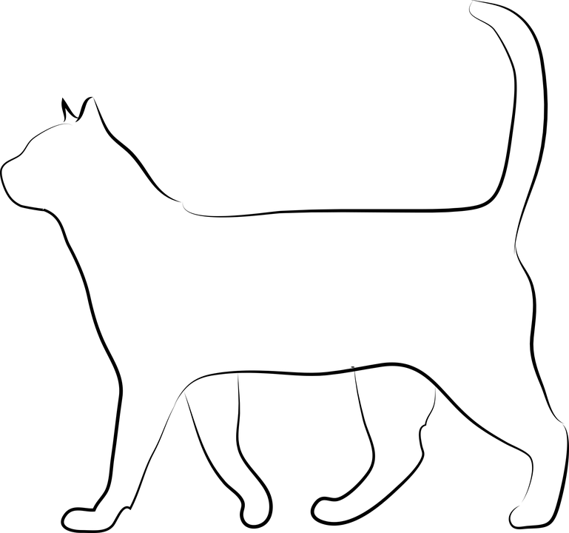
Of Mice and Men…and Money
U.S. structural pest control industry: >$7.5B
Forecasted growth rate of U.S. pest control services industry: 4.6%
68% of market revenue driven by residential services
July 14, 2017: “NYC announces $32 million neighborhood rat reduction plan”
An internet connected mousetrap was launched by Rentokil in the UK…
for $1,700
http://www.pctonline.com/article/global-pest-market-report-2017/
http://www.pctonline.com/article/nyc-rat-reduction-plansaspx/
https://www.statista.com/statistics/706878/pest-control-services-revenue-united-states-by-service-area/
https://www.theregister.co.uk/2017/02/23/rentokil_1300_pound_iot_mousetrap/

Slide 4
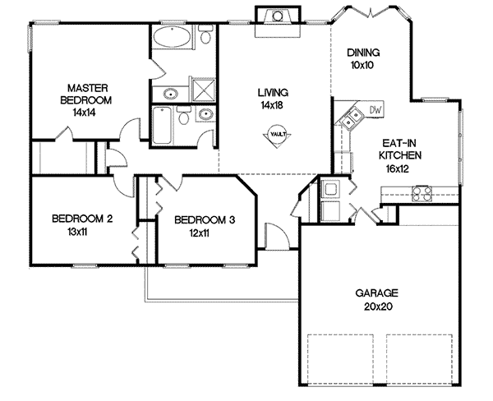
Initial Goal: residential monitoring for mice
Inform homeowner of pest activity and where
Less need for constantly checking traps
Minimize next level pests
Limits uncommon scents
Rented hardware and service until mice are controlled
= Device Location

Slide 5
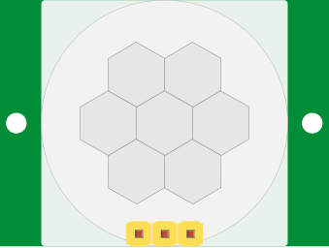
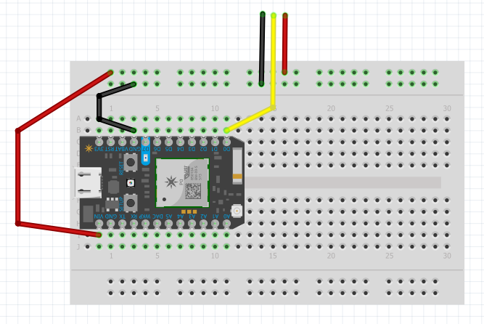
Hardware: setup and parts
HC-SR501 PIR Sensor
Particle Photon
Passive Infrared Sensor
5 wires
All parts available from Particle Photon Maker-Kit

Slide 6
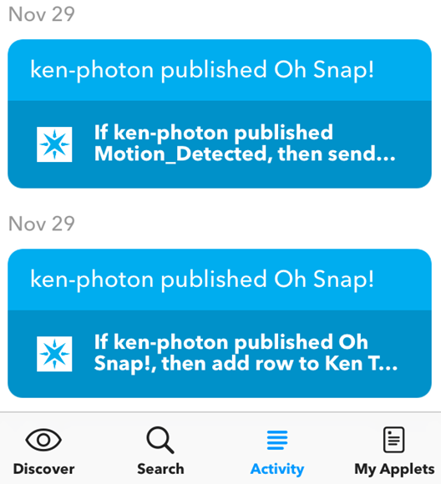





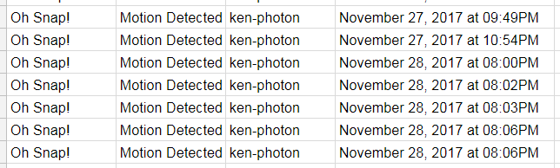
Capturing the event and data
alert
data

Slide 7
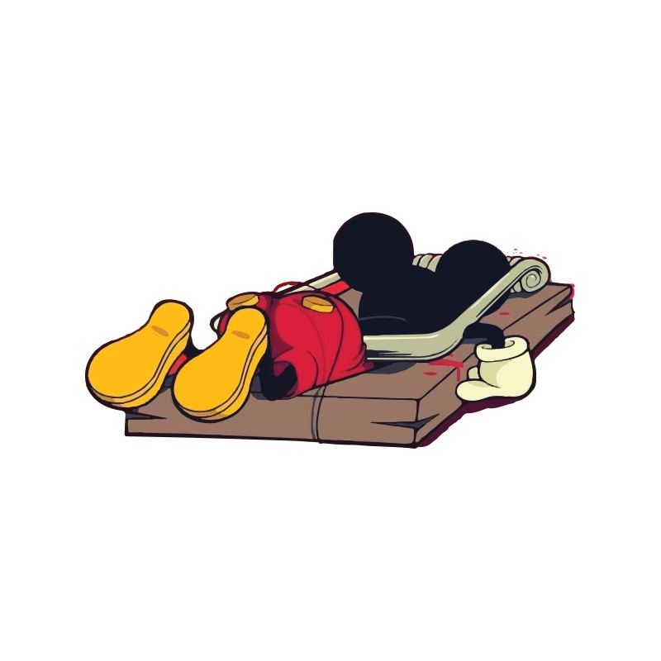
Demonstration

Slide 8
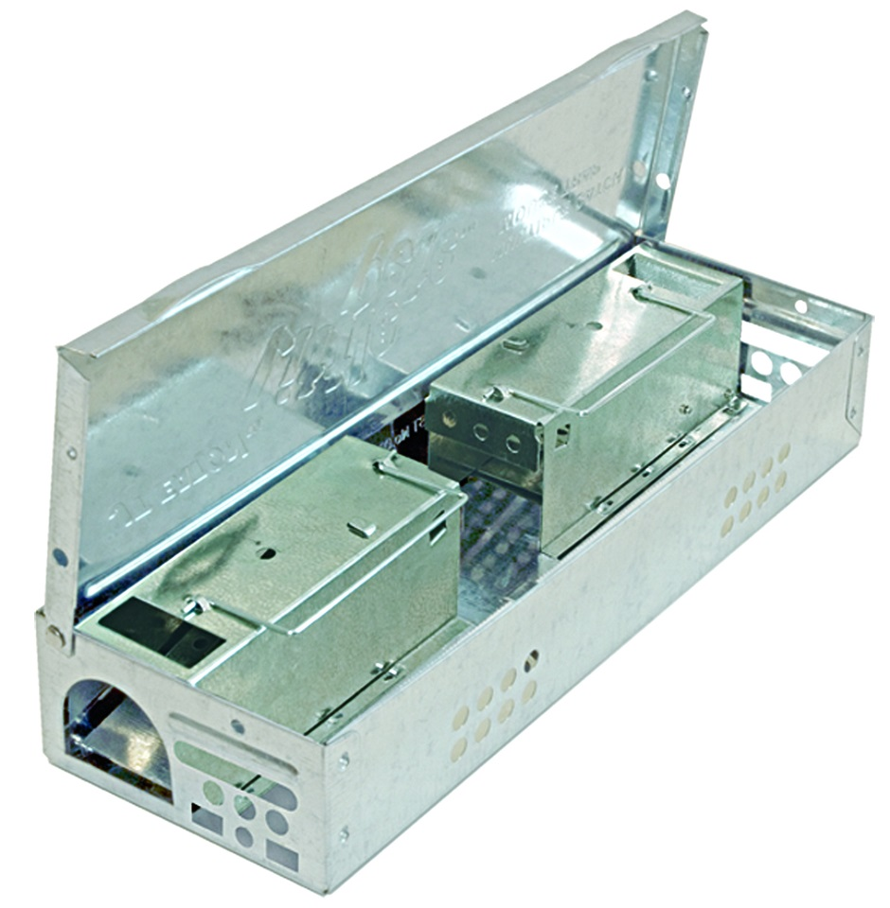
Microcontroller and battery on outside of container
Future Goal: scale for commercial use
Proactive service and removal
Real-time data and reporting
Analysis for trend and behavior data
Product extensions – roach, ant, flies
Construction company partnership
Motion Sensor on inside
Design considerations:
LoRaWAN for communication
(De)activate devices remotely
Battery powered
Additional sensors and GPS

Slide 9
Data Visualization and Value Proposition
Prove to your customer your services accomplished the goal

Slide 10

Questions

